Slide 1
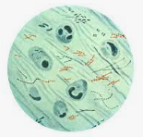
TB in LTC
Focus: TB Annual Risk Assessment

Slide 2
TB in LTC Tuberculosis (TB) is a disease caused by Mycobacterium tuberculosis in the body. We know it for the pulmonary disease, but it can also cause infections elsewhere.
TB Disease
M. Tuberculosis lives in the body and is characterized by:
Bad cough that lasts 3 weeks or longer
Chest Pain
Coughing blood or sputum
Weakness or Fatigue
Weight loss
No appetite
Chills
Fever
Sweating at night
Contagious
Latent TB Infection (LTBI)
M. Tuberculosis lives in the body but does not cause illness.
No symptoms
Do NOT Feel Sick
Is NOT contagious
May become an active TB Disease if not treated properly.

Slide 3
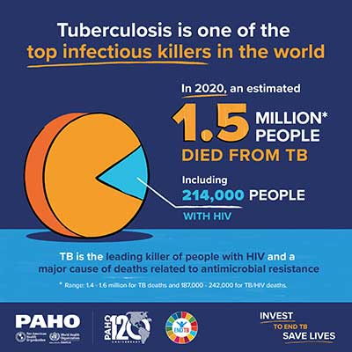
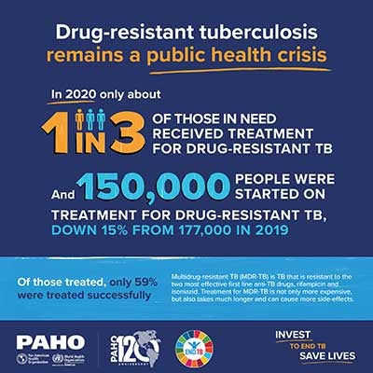
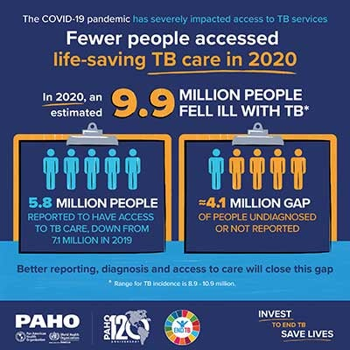
TB in the WORLD Today
“During 1993–2019, the incidence of tuberculosis (TB) in the United States decreased steadily;
however, during the later years of that period the annual rate of decline slowed until 2020 when a substantial decline (19.9%) was observed.” In 2021 a 9.4% increase occurred. However, continues to be significant drop from 2019. Experts are concerned these numbers are due to undiagnosed cases.

Slide 4
LTC TB Risk Factors
Adults aged ≥65 have the highest TB rates.
Approximately 90% of cases among older adults are from reactivation of latent infection DUE to increased susceptibility and comorbidity
Congregate Living

Slide 5
What are we to do?
DECREASE the RISK of EXPOSURE to TB
THINK - TEST – TREAT
EARLY DETECTION, RECOGNITION, TREATMENT
Complete an Annual TB risk assessment
Screen employees and patients at risk for TB
Provide TB education for employees, patients, and families

Slide 6
Education: CDC Train Module 12B- Tuberculosis Prevention https://www.train.org/cdctrain/course/1081820/

Slide 7
State
Tuberculosis (TB) screening and testing of health care personnel is recommended as part of a TB Infection Control Plan and might be required by state regulations. For TB regulations in your area, please contact your state or local TB control program.

Slide 8
Pennsylvania Tuberculosis Program https://www.health.pa.gov/topics/programs/Tuberculosis/Pages/Tuberculosis.aspx

Slide 9
West Virginia Tuberculosis Program https://oeps.wv.gov/tuberculosis/pages/default.aspx

Slide 10
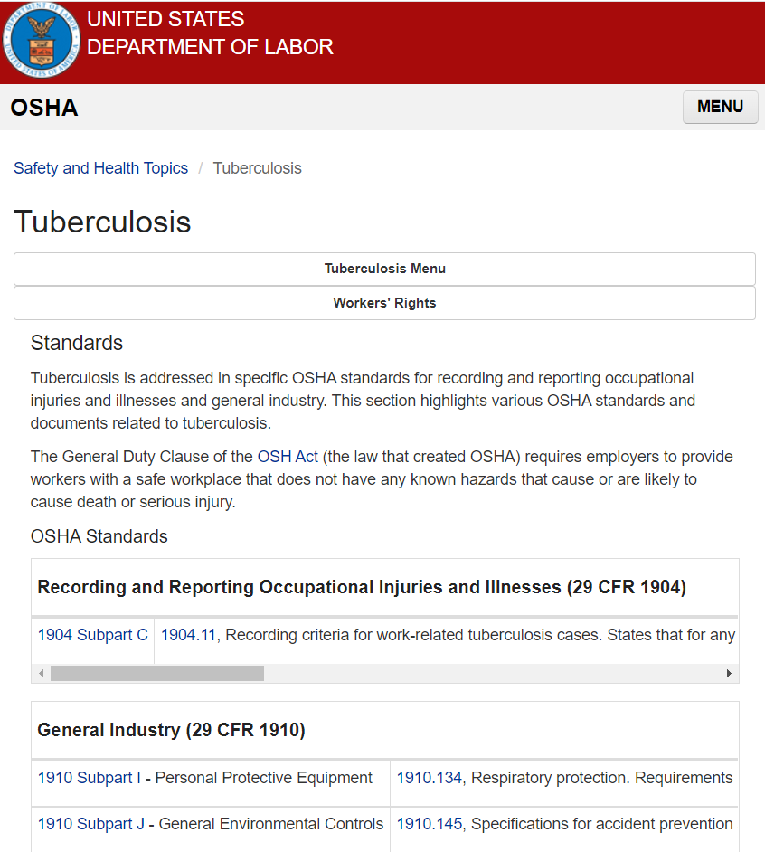
OSHA
https://www.osha.gov/tuberculosis/standards
Requirements under OSHA's Respiratory Protection Standard, 29 CFR 1910.134
Employers must comply with applicable provisions of OSHA's Respiratory Protection standard, 29 CFR 1910.134, for using respirators to protect against TB hazards, including:
Following the hierarchy of controls required by the standard and providing appropriate respirators when such equipment is necessary to protect the health of the employee(s). The minimally acceptable level of respiratory protection for TB is the Type N95 Respirator. [29 CFR 1910.134(a)]
Establishing and implementing a written respiratory protective program that includes the elements required by 29 CFR 1910.134(c).
Training employees in the respiratory hazards to which they are potentially exposed during routine and emergency situations. [29 CFR 1910.134(c)(1)(vii)]
Complying with other provisions of the standard, including those provisions requiring respirator training, medical evaluations, fit testing, a written respiratory protection program, and recordkeeping, at no cost to the employee.

Slide 11
CMS Guidance
Regulations: Appendix PP
§483.70(e) Facility Assessment (F838)
A community-based risk assessment should include review for risk of infections (e.g., multidrug-resistant organisms- MDROs) and communicable diseases such as tuberculosis and influenza.
Appropriate resident tuberculosis screening should be performed based on state requirements.
INFECTION CONTROL POLICIES AND PROCEDURES
The facility must develop and implement written policies and procedures for the provision of infection prevention and control. The facility administration and medical director should ensure that current standards of practice based on recognized guidelines are incorporated in the resident care policies and procedures. These IPCP policies and procedures must include, at a minimum:
o Assessing risks for tuberculosis (TB) based on regional/community data and screening staff to the extent permitted under applicable federal guidelines 49 and state law;
§483.80 Infection Control (F880)
The facility must establish and maintain an infection prevention and control program designed to provide a safe, sanitary and comfortable environment and to help prevent the development and transmission of communicable diseases and infections.

Slide 12
The Guidance: CDC Annual TB Risk Assessment 2005 https://www.cdc.gov/mmwr/preview/mmwrhtml/rr5417a1.htm
Initial, as indicated and then at least annual evaluation for the risk of TB Transmission in your facility

Slide 13
Every Year on March 24th
National Rates are released on this day.
Can be used to signify the time frame for the TB Annual Risk Assessment and TB education to be completed.

Slide 14
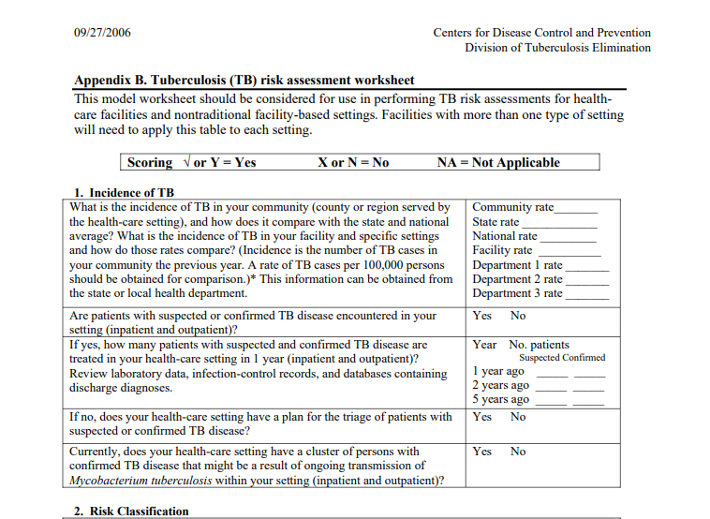
Appendix B. Tuberculosis (TB) Risk assessment worksheet https://www.cdc.gov/tb/publications/guidelines/appendixb_092706.pdf

Slide 15
2021 National, State, County TB Rates Call the STATE TB Program for county #s

Slide 16
National Numbers are released on World Tuberculosis Day
MMWR: Tuberculosis- United States, 2021 https://www.cdc.gov/mmwr/volumes/71/wr/mm7112a1.htm

Slide 17
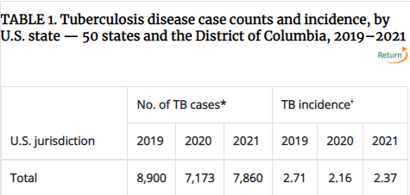
PA, WV and Surrounding States
DO you SEE a trend?

Slide 18
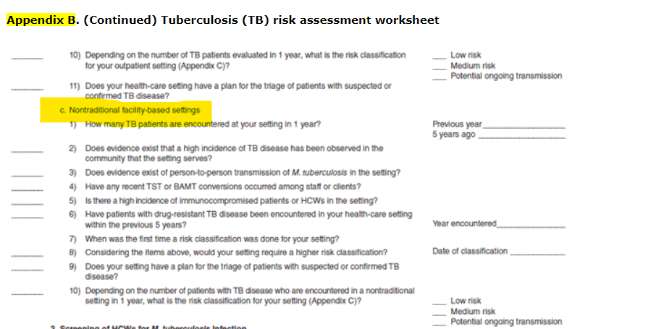
Annual TB Risk Assessment: Risk Classification

Slide 19
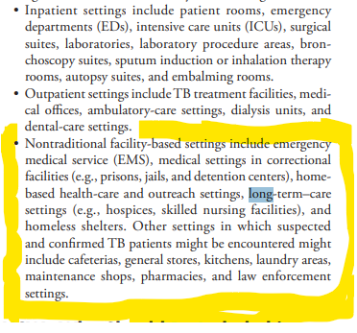
TB Risk Classification
Long-term care settings are considered
Nontraditional facility-based Setting
“Guidelines for Preventing the Transmission of Mycobacterium tuberculosis in Health-Care Settings, 2005”

Slide 20
TB Risk Classification

Slide 21
2019 CDC Updated TB management for Healthcare Personnel Guidance https://www.cdc.gov/mmwr/volumes/68/wr/mm6819a3.htm?s_cid=mm6819a3_w

Slide 22
2005 vs 2009 Recommendations https://www.cdc.gov/mmwr/volumes/68/wr/mm6819a3.htm?s_cid=mm6819a3_w#B1_down

Slide 24
2019 TB at Baseline Healthcare Personnel Assessment

Slide 25
2019 HCP Individual TB Risk Assessment

Slide 26
Risk, Screen and Testing Form Example

Slide 27
Questions?
Thank you!

