Slide 1
MDS Changes are Coming
Are you ready for October 1, 2023?
Debra Wright, RN, BSN, RAC-CT
Quality Improvement Specialist

Slide 2
Helpful Links
MDS FORMS AND RAI MANUAL
https://www.cms.gov/medicare/quality-initiatives-patient-assessment-instruments/nursinghomequalityinits/mds30raimanual
CMS Official YouTube Channel
https://www.youtube.com/cmshhsgov

Slide 3
CMS Library of Training Videos

Slide 4
Global Changes to the MDS 3.0 RAI Manual
Content updated with gender-neutral language.
Minor updates to wording to enhance understanding.
Coding examples modified to improve clarity.
Quality Improvement and Evaluation System (QIES) was changed to iQIES.
Revisions made pertaining to legal/proxy information for family member, significant other, and/or guardian/legally authorized representative to provide consistency.
Understanding Changes to the MDS 3.0 RAI v1.18.11

Slide 5
Where are the changes?
Revisions to Chapter Guidance
Chapter 1
Chapter 2
Chapter 4
Revised Data Elements and/or New/Revised Guidance in Chapter 3
Section A
Section B
Section C
Section D
Section F
Section H
Section I
Section M
Section X

Slide 6
Section A – Identification Information

Slide 7
The Intent of Section A
To obtain the reasons for assessment, administrative information, and key demographic information to uniquely identify each resident, potential care needs including access to transportation, and the home in which they reside.

Slide 8
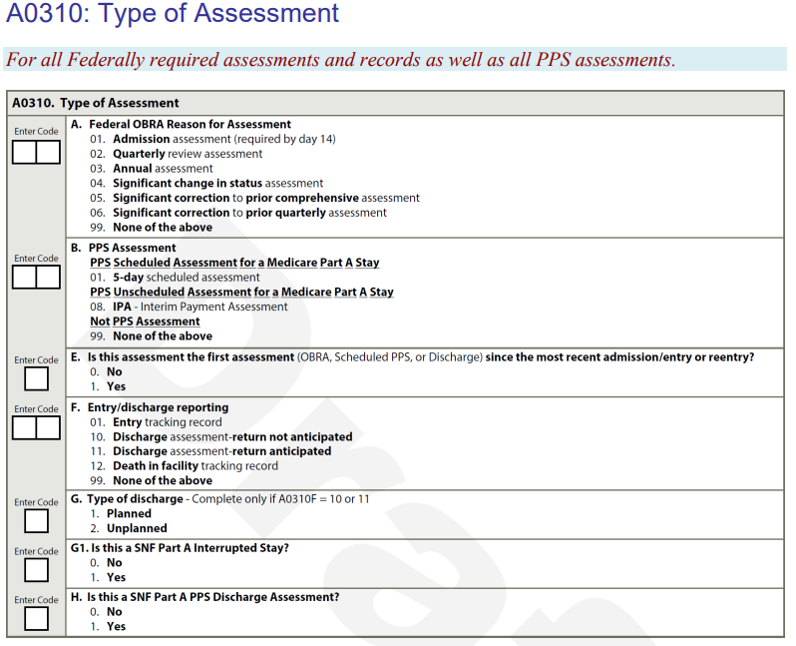
Notice – Only Federally Required and PPS Assessments (A0310A-H) Optional State Assessment (A0300) was removed *
A0310: Type of Assessment
For all Federally required assessments and records as well as all PPS assessments
*OSA will be discussed at a later time for PA SNFs

Slide 9
Ethnicity- Expanded
What does the resident identify as?
Ask the resident to select the category or categories that most closely correspond to their ethnicity from the list in A1005.
Individuals may be more comfortable if this question is introduced by saying, “We want to make sure that all our residents get the best care possible, regardless of their ethnic background. We would like you to tell us your ethnic background so that we can review the treatment that all residents receive and make sure that everyone gets the highest quality of care” (Baker et al., 2005).

Slide 10
Ethnicity Coding
Only use medical record documentation to code A1005, Ethnicity if the resident is unable to respond and no family member, significant other, and/or guardian/legally authorized representative provides a response for this item.
If the resident declines to respond, do not code based on other resources (family, significant other, or guardian/legally authorized representative or medical records).
If the resident provides a response, check the box(es) indicating the ethnic category or categories identified by the resident.
Code X, Resident unable to respond: if the resident is unable respond. In the cases where the resident is unable to respond and the response is determined via family, significant other, or legally authorized representative input or medical record documentation, check all boxes that apply, including X. Resident unable to respond.
If the resident is unable to respond and no other resources (family, significant other, or legally authorized representative or medical records) provided the necessary information, code A1005 as X. Resident unable to respond.
Code Y, Resident declines to respond: if the resident declines to respond. — When the resident declines to respond, code only Y. Resident declines to respond. — When the resident declines to respond do not code based on other resources (family, significant other, or legally authorized representative or medical records).

Slide 11
Example
Resident R is admitted following an acute cerebral vascular accident (CVA) with mental status changes and is unable to respond to questions regarding their ethnicity. Their spouse informs the nurse that Resident R is Cuban.
Coding: A1005 would be coded as D. Yes, Cuban and X. Resident unable to respond.
Rationale: If Resident R is unable to respond but their family, significant other, or legally authorized representative provided the response, code both that response and X. Resident unable to respond.
Resident K is admitted following a total hip arthroplasty and declines to respond when asked their ethnicity.
Coding: A1005, Ethnicity would be coded as Y. Resident declines to respond.
Rationale: If a resident declines to respond to this item, code only Y. Resident declines to respond. Do not use other resources (family, significant other, or legally authorized representative or medical record documentation) to complete A1005, Ethnicity when a resident declines to respond.

Slide 12
Race- Expanded
What does the resident identify as?
Standardizing self-reported data collection for race allows for the equal comparison of data across multiple post-acute-care settings.
These categories are NOT used to determine eligibility for participation in any Federal program.
Individuals may be more comfortable if this question is introduced by saying, “We want to make sure that all our residents get the best care possible, regardless of their racial background. We would like you to tell us your racial background so that we can review the treatment that all residents receive and make sure that everyone gets the highest quality of care” (Baker et al., 2005).

Slide 13
Race Coding
If the resident is unable to respond, the assessor may ask a family member, significant other, and/or guardian/legally authorized representative.
Respondents should be offered the option of selecting one or more racial designations.
Only use medical record documentation to code A1010, Race if the resident is unable to respond and no family member, significant other, and/or guardian/legally authorized representative provides a response for this item.
If the resident declines to respond, do not code based on other resources (family, significant other, or legally authorized representative or medical records).
If the resident provides a response, check the box(es) indicating the race category or categories identified by the resident.
Code X, Resident unable to respond: if the resident is unable to respond. — In the cases where the resident is unable to respond and the response is determined via family, significant other, or legally authorized representative input or medical records, check all boxes that apply, including X. Resident unable to respond. — If the resident is unable to respond and no other resources (family, significant other, or legally authorized representative or medical records) provided the necessary information, code as X. Resident unable to respond.
Code Y, Resident declines to respond: if the resident declines to respond. — When the resident declines to respond, code only Y. Resident declines to respond. — When the resident declines to respond do not code based on other resources (family, significant other, or legally authorized representative or medical records).
Code Z, None of the above: if the resident reports or it is determined from other resources (family, significant other, or legally authorized representative or medical records) that none of the listed races apply.

Slide 14
Example
Resident W has severe dementia with agitation. During the Admission assessment, they are unable to provide their race. Their child informs the nurse that Resident W is Korean and African American.
Resident Q declines to provide their race during the admission assessment stating “I’d rather not answer.”
Coding: A1010, Race would be coded as B. Black or African American, H. Korean, and X. Resident unable to respond.
Rationale: If Resident W is unable to respond but their family, significant other, or legally authorized representative provided the response, code those responses and X. Resident unable to respond.
Coding: A1010, Race would be coded as Y. Resident declines to respond.
Rationale: If a resident declines to respond to this item, then code only Y. Resident declines to respond. Do not make attempts to code A1010, Race when a resident declines to respond based on other resources (family, significant other, or legally authorized representative or medical records).

Slide 15
Language- Revised

Slide 16
Language Coding
Enter the preferred language the resident primarily speaks or understands after interviewing the resident and family, significant other and/or guardian/legally authorized representative and/or reviewing the medical record.
If the resident, family member, significant other, guardian/legally authorized representative and/or medical record documentation cannot or does not identify preferred language, enter a dash (—) in the first box. A dash indicates “no information.” CMS expects dash use to be a rare occurrence.
Code 0, No: if the resident (family, significant other, guardian/legally authorized representative or medical record) indicates there is no need or want of an interpreter to communicate with a doctor or health care staff.
Code 1, Yes: if the resident (family, significant other, guardian/legally authorized representative or medical record) indicates the need or want of an interpreter to communicate with a doctor or health care staff. Ensure that preferred language is indicated.
Code 9, Unable to determine: if the resident is unable or declines to respond or any available source (family, significant other, guardian/legally authorized representative or medical records) cannot or does not identify the need or want of an interpreter.

Slide 17
Transportation - New

Slide 18
Steps for Assessment: Interview Instructions
Ask the resident: “In the past six months to a year, has lack of transportation kept you from medical appointments or from getting your medications?”
“In the past six months to a year, has lack of transportation kept you from non-medical meetings, appointments, work, or from getting things that you need?”
Respondents should be offered the option of selecting more than one “yes” designation, if applicable.
If the resident is unable to respond, the assessor may ask a family member, significant other, and/or guardian/legally authorized representative.
Only if the resident is unable to respond and no family member, significant other, and/or guardian/legally authorized representative may provide a response for this item, use medical record documentation.
If the resident declines to respond, do not code based on other resources (family, significant other, or legally authorized representative or medical records).

Slide 19
Transportation Coding
Code A, Yes, it has kept me from medical appointments or from getting my medications: if the resident indicates that lack of transportation has kept the resident from medical appointments or from getting medications.
Code B, Yes, it has kept me from non-medical meetings, appointments, work, or from getting things that I need: if the resident indicates that lack of transportation has kept the resident from non-medical meetings, appointments, work, or from getting things that the resident needs.
Code C, No: if the resident indicates that a lack of transportation has not kept the resident from medical appointments, getting medications, non-medical meetings, appointments, work, or getting things that the resident needs.
Code X, Resident unable to respond: if the resident is unable to respond. — In the cases where the resident is unable to respond and the response is determined via family, significant other, or legally authorized representative input or medical records, check all boxes that apply, including X. Resident unable to respond. — If the resident is unable to respond and no other resources (family, significant other, or legally authorized representative or medical records) provided the necessary information, code A1250 as only X. Resident unable to respond.
Code Y, Resident declines to respond: if the resident declines to respond. — When the resident declines to respond, code only Y. Resident declines to respond. — When the resident declines to respond do not code based on other resources (family, significant other, or legally authorized representative or medical records).

Slide 20
Example:
Resident E is admitted with Multiple Sclerosis. They are confused and unable to understand when asked if they have had a lack of transportation that has kept them from medical appointments, meetings, work, or from getting things needed for daily living. No family, significant other, or legally authorized representative with related information is available, but their medical record indicates that their spouse uses their car to transport Resident E wherever they need to go.
Coding: A1250 would be coded as C. No and X. Resident unable to respond.
Rationale: If neither Resident E nor their family, significant other, or legally authorized representative was able to provide a response but the medical record documentation can provide the necessary information, code both the information in the medical record and X. Resident unable to respond.

Slide 21
Entered from/Discharge to- Expanded

Slide 22
Provision of Current Reconciled Medication List to Subsequent Provider at Discharge- New
Was the resident discharged to one of these subsequent providers: For the purposes of coding this item, a subsequent provider is based on the discharge locations in A2105 and defined as any of the following: 02. Nursing home (long-term care facility)
03. Skilled nursing facility (SNF, swing beds)
04. Short-term general hospital (acute hospital, IPPS)
05. Long-term care hospital (LTCH)
06. Inpatient rehabilitation facility (IRF, free standing facility or unit)
07. Inpatient psychiatric facility (psychiatric hospital or unit)
08. Intermediate care facility (ID/DD facility)
09. Hospice (home/non-institutional)
10. Hospice (institutional facility)
11. Critical access hospital (CAH)
12. Home under care of organized home health service organization

Slide 23
Rationale and Coding
The transfer of a current reconciled medication list at the time of discharge can improve care coordination and quality of care and help subsequent providers reconcile medications, and it may mitigate adverse outcomes related to medications. Communication of medication information at discharge is critical to ensure safe and effective transitions from one health care setting to another.
Code 0, No: if at discharge to a subsequent provider, your facility did not provide the resident’s current reconciled medication list to the subsequent provider, or the resident was not discharged to a subsequent provider.
Code 1, Yes: if at discharge to a subsequent provider, your facility did provide the resident’s current reconciled medication list to the subsequent provider.

Slide 24
Definition and Coding Tips
MEANS OF PROVIDING A CURRENT RECONCILED MEDICATION LIST = Providing the current reconciled medication list at the time of transfer or discharge can be accomplished by any means, including active means (e.g., by mail, electronically, or verbally) and more passive means (e.g., a common electronic health record [EHR]), giving providers access to a portal)
In the case of a standalone Medicare Part A PPS Discharge assessment (A0310A = 99, A0310B = 99, A0310F = 99, and A0310H = 1) with the resident staying on the same unit and with the same team of interdisciplinary professionals, code A2121. Provision of Current Reconciled Medication List to Subsequent Provider at Discharge as 1, Yes.
In the case of a standalone Medicare Part A PPS Discharge assessment (A0310A = 99, A0310B = 99, A0310F = 99, and A0310H = 1) and the resident is moving to a different unit and/or interdisciplinary team (IDT), code A2121. Provision of Current Reconciled Medication List to Subsequent Provider at Discharge based on whether a member of the resident’s IDT transferred the resident’s current reconciled medication list to the subsequent unit and/or IDT.

Slide 25
Examples:
Resident F was transferred to an acute care hospital with a reconciled medication list that included a list of their current medications, but with less additional information than is usually provided by the SNF at discharge because of the urgency of the situation. Some of the contraindications for the medications, as well as resident weight and height and dates taken, were omitted from the medication list.
Resident J’s Medicare Part A stay ended, and they were transferred to a long-term care unit in the same nursing home. The IDT from the subacute unit staff provided and reviewed with the long-term care unit staff a reconciled medication list at the time of transfer.
Resident G’s reconciled medication list was electronically faxed to the subsequent provider, and this action is documented in their clinical record. However, the subsequent provider’s records do not show documentation that the fax was successfully received.
Coding: A2121 would be coded 1, Yes.
Rationale: As long as a current reconciled list of medications is provided to the admitting provider, this item should be coded 1, Yes.
Coding: A2121 would be coded 1, Yes.
Rationale: If a current reconciled list of medications is provided to the subsequent provider (in this case, a different unit staff in the same nursing home), this item should be coded 1, Yes.
Coding: A2121, would be coded 1, Yes.
Rationale: Documentation of the subsequent provider’s successful receipt of the reconciled medication list is not a required component for this item.

Slide 26
Route of Reconciled Medication List- New

Slide 27
Provision of Current Reconciled Medication List to Resident at Discharge- New
Code 0, No: if at discharge to a home setting (A2105 = 01) or a not listed location (A2105 = 99), your facility did not provide the resident’s current reconciled medication list to the resident, family, guardian/legally authorized representative, and/or caregiver.
Code 1, Yes: if at discharge to a home setting (A2105 = 01) or a not listed location (A2105 = 99), your facility did provide the resident’s current reconciled medication list to the resident, family, guardian/legally authorized representative, and/or caregiver.

Slide 28
Route of Reconciled Medication List- New

Slide 29
Coding Tips- Route of Reconciled Medication List
The route of transmission usually is established with each subsequent provider, depending on how it is able to receive information from your facility. The route(s) may not always be documented in the resident’s record. It will be helpful to understand and document how your facility typically transmits information to each subsequent provider at discharge to prepare for coding this item.
More than one route of transmission may apply. Check all that apply

Slide 30
Questions

Slide 31
Resources
https://www.cms.gov/files/document/draftmds-30-rai-manual-v11811october2023.pdf-0
https://www.cms.gov/medicare/quality-initiatives-patient-assessment-instruments/nursinghomequalityinits/mds30raimanual
https://www.youtube.com/cmshhsgov
This material was prepared by Quality Insights, a Quality Innovation Network - Quality Improvement Organization under contract with the Centers for Medicare & Medicaid Services (CMS), an agency of the U.S. Department of Health and Human Services (HHS). Views expressed in this material do not necessarily reflect the official views or policy of CMS or HHS, and any reference to a specific product or entity herein does not constitute endorsement of that product or entity by CMS or HHS. Publication number 12SOW-QI-GEN-072623-KS

